Slide 1


Slide 2
Efficient Halo Exchange For Stencil-Based Scientific Codes on Cerebras Wafer-Scale Engine
Amartya Yadav
Developed at Edinburgh Parallel Computing Centre (EPCC), University of Edinburgh

Slide 3
Outline
Cerebras WSE-3 Architecture
WSE Programming
Halo-Exchange
Checkerboard Pattern of Communication
Implementing a simple halo-exchange in CSL

Slide 4
Dataflow Model, Cerebras WSE and WSE architecture

Slide 5
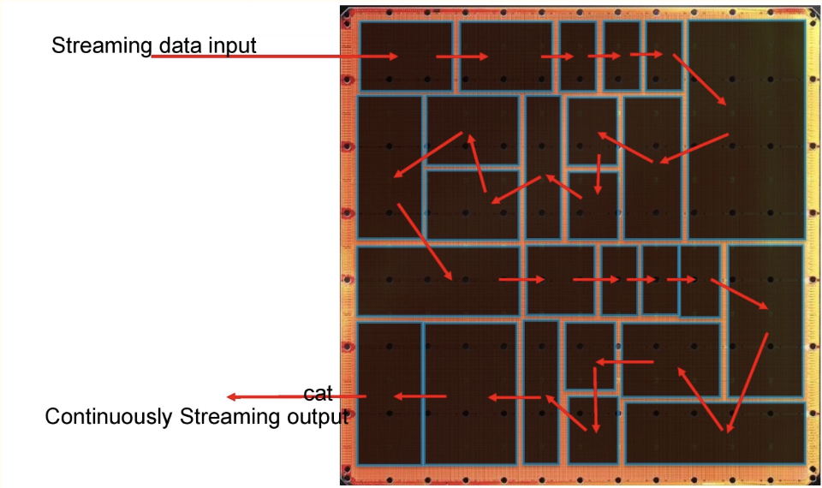
Dataflow Model
"Dataflow machines are programmable computers of which the hardware is optimized for fine-grain data-driven parallel computation.”¹
Characterised by spatial parallelism
Tens of thousands of processors
Fast on-chip network between processors
Generally, lacks centralised memory
Usually power efficient
1 https://dl.acm.org/doi/10.1145/27633.28055

Slide 6
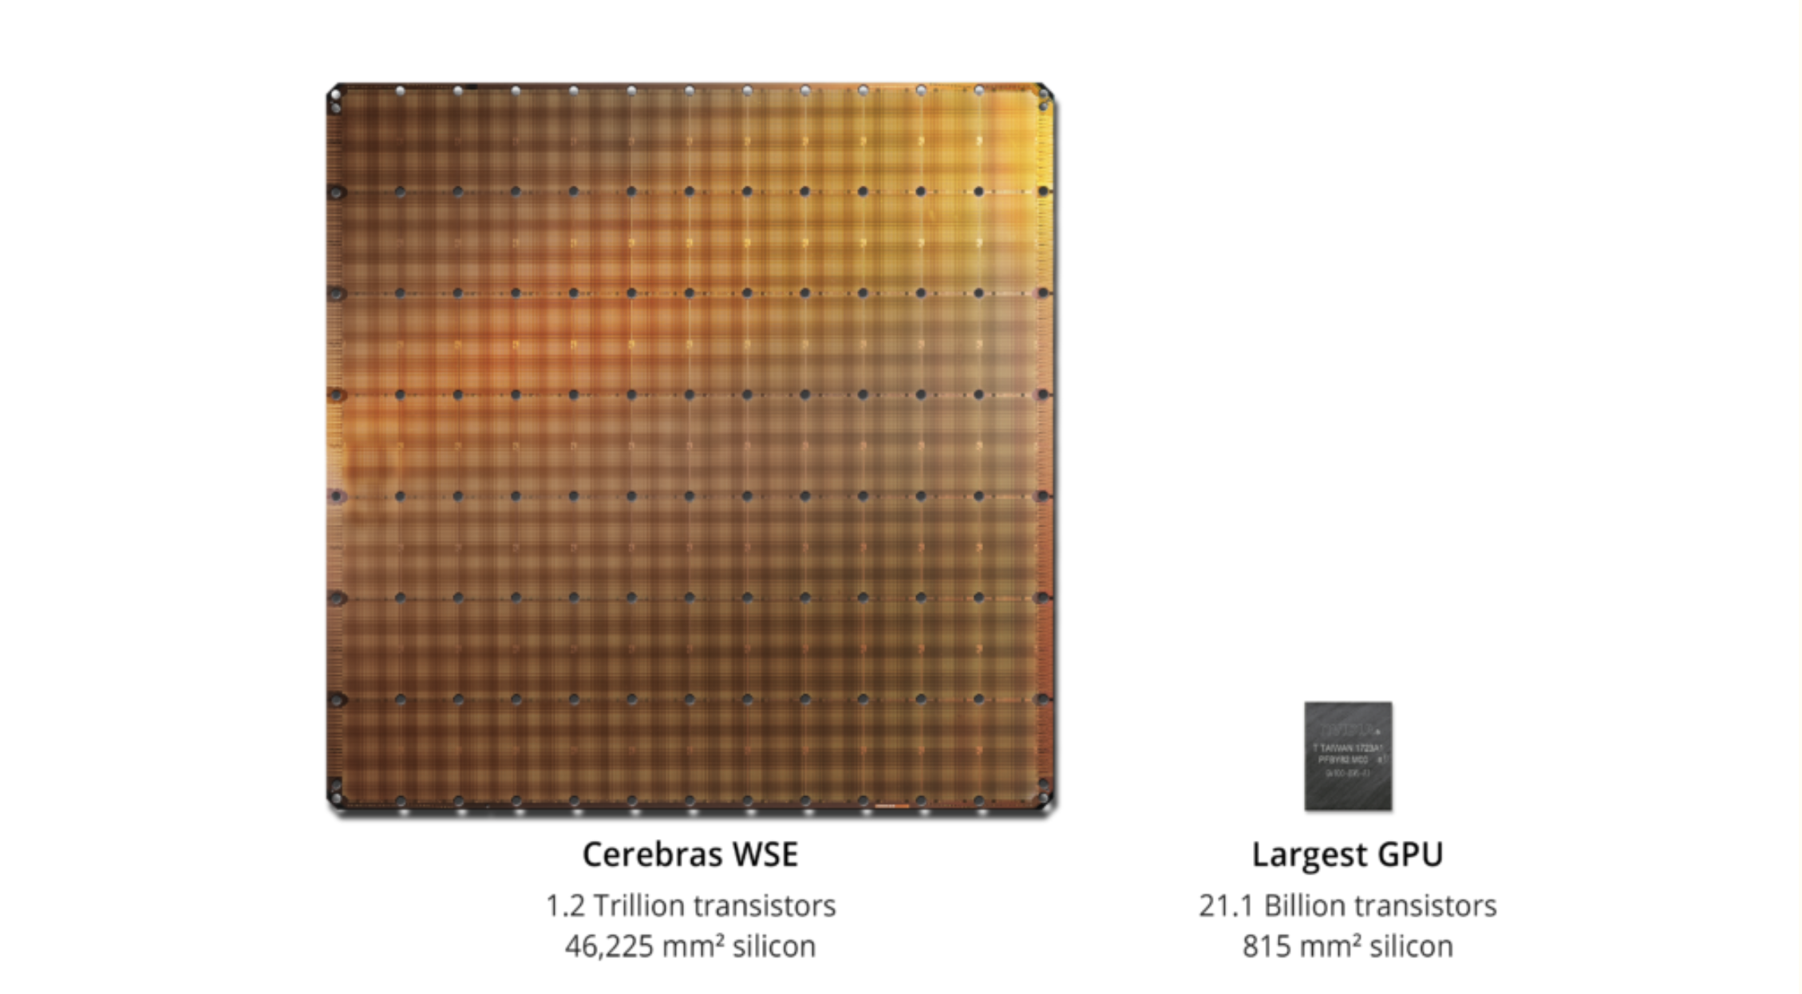
Cerebras WSE-3 vs Largest GPU

Slide 7
Wafer Scale Engine (WSE)
Made by Cerebras
Built upon a 5nm process technology
The current generation WSE-3 specs:
900,000 independent cores
44GB on-chip SRAM memory
21PB/s aggregate memory bandwidth
214 Pb/s processor to processor fabric bandwidth
The flexibility of the independent cores and the large amount of memory means that, the WSE-3 is capable of delivering the performance of many GPUs

Slide 8
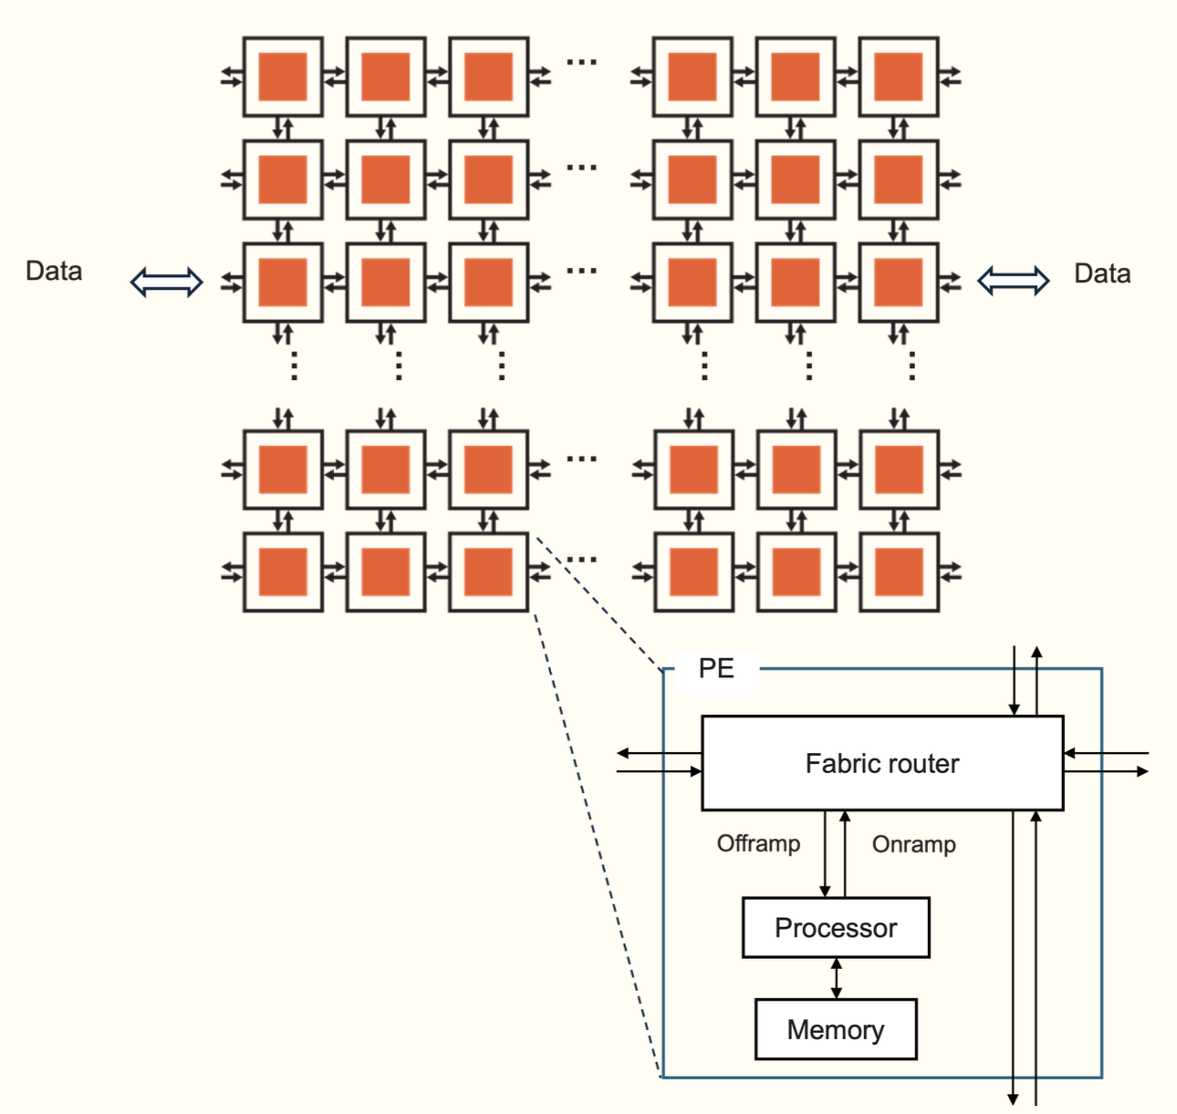
WSE PE Details
The processor itself
Commonly referred to as the Compute Engine (CE)
Independent and private from any other
A router
Connected with bidirectional links to own CE and router of four neighbours
Link to own CE is called the RAMP and neighbours are referred to by north, south, east and west
This is the only way in which PEs can communicate
Local (private) memory
All data and code for the PE is stored in this memory
48KB per PE

Slide 9
WSE Programming

Slide 10

Programming the WSE
For machine learning - PyTorch
The original and primary workload
For everything else - Cerebras Software Language (CSL)
Based on the Zig language
Host CPU(s): Python
Loads program onto CSX system
Streams in/out data from/to device
Launches device functions
Device: CSL
CSL programs run on groups of cores on the WSE, specified by programmer
Executes dataflow programs

Slide 11
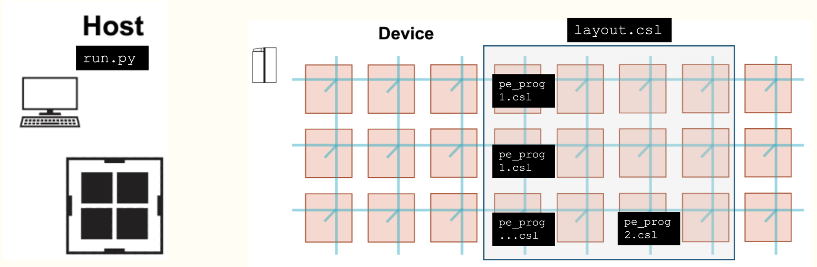
The Components of a Program

Slide 12
Programming the WSE - communication
A wavelet is a 32-bit message communicated with a neighbour in a single cycle
Each physical channel has 24 virtual communication channels known as colors that can be used for passing wavelets
Each wavelet has associated with it a 5-bit identifier which defines which channel it is communicated on
Determines the wavelet’s routing through the fabric and its consumption
This is a bit like a tag in MPI point-to-point communications

Slide 13
Data Structure Descriptors
Think of it like MPI Derived Datatypes – essentially an array and an access pattern represented together in a single structure.
Useful because adding two arrays (elementwise using a loop) is inefficient as compared to a ‘DSD add operation’ which is done on the entire tensor, which is h/w and compiler optimised. And other type -
Two types of DSDs –
Memory DSD -> used to perform operations on a tensor as aforementioned
Fabric DSD -> used to receive and send wavelets using fabout_dsd and fabin_dsd to the fabric along a color.

Slide 14
Halo Exchange

Slide 15
Halo Exchange - briefly
Halo exchange is the communication of boundary data between neighbouring subdomains in a decomposed computational grid.
Ensures each process has up-to-date values in its ghost/halo cells required for stencil computations.
Typically involves point-to-point communication (e.g., MPI send/recv).
Critical for maintaining data consistency, accuracy, and scalability across distributed memory systems (yes, WSE is like a dist. memory system – loosely speaking).

Slide 16
Halo Exchange - continued
Usually simple enough to perform the p2p communication required to send the data b/w computing nodes in a traditional cluster or processor.
Gets tricky in WSE – "we cannot safely send and receive multiple wavelets on the same color with a fixed routing”¹
Result – we need to use a checkerboard communication pattern between the PEs.
Checkerboard pattern ---- extremely complicated layout.csl file.
1 https://sdk.cerebras.net/csl/code-examples/tutorial-gemv-08-routes-3

Slide 17
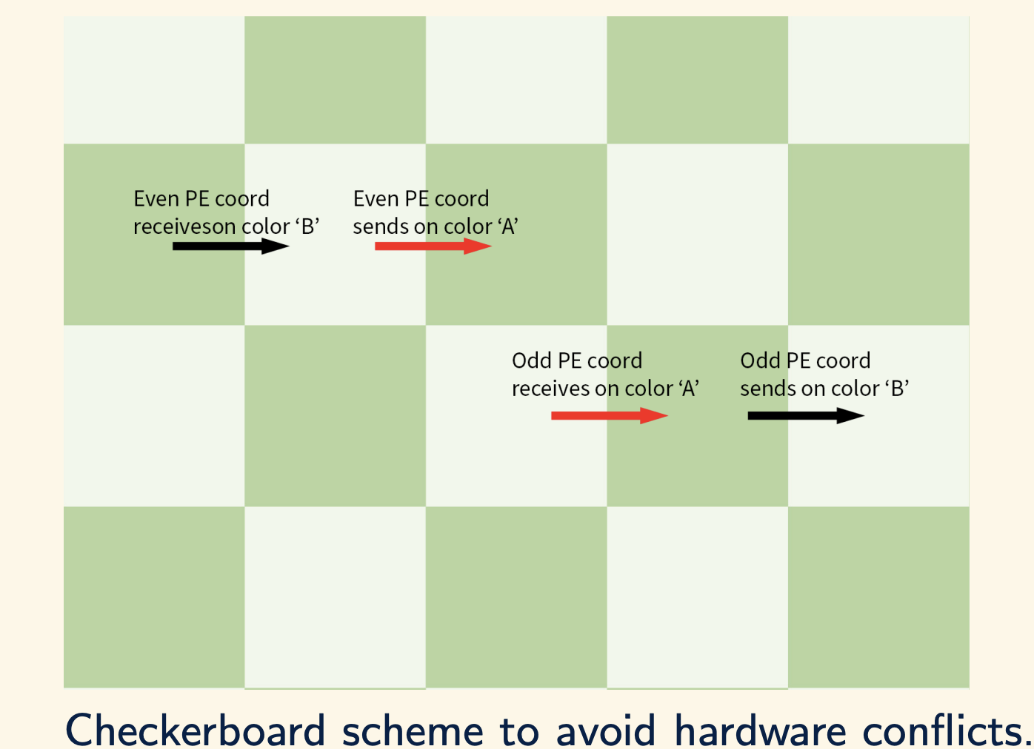
Checkerboard Comm. Model
Each PE has a coordinate (0,0), (1,0), (3,1) etc.
Need to use different colors for sending/receiving to/from a direction for a PE.
Even PEs (0+0=0 - even)
Odd PEs (2+1=3 - odd)
Looks simple enough as a concept here diagrammatically, but in code…
1 https://sdk.cerebras.net/csl/code-examples/tutorial-gemv-08-routes-3

Slide 18
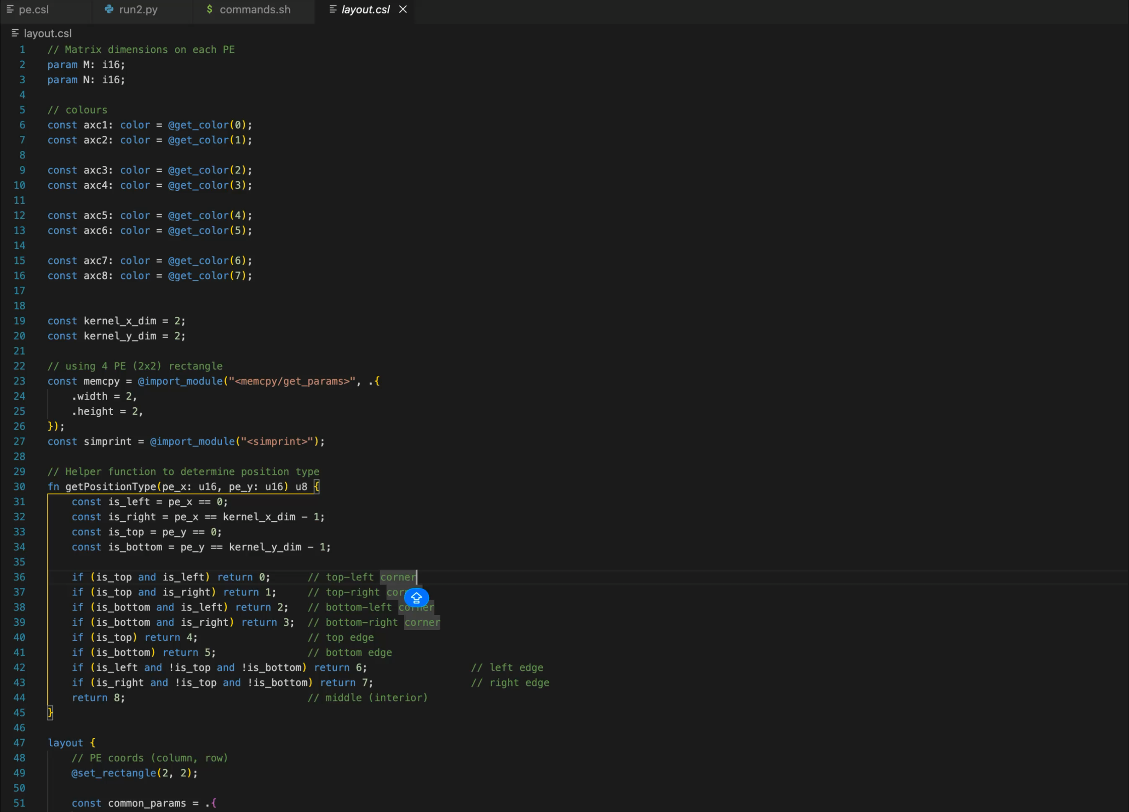
THE LAYOUT.CSL FILE FOR CHECKERBOARD PATTERN
1 https://sdk.cerebras.net/csl/code-examples/tutorial-gemv-08-routes-3

Slide 19
THANK YOU

